Slide 1

Submitted to : Dr. Shaheena Sultana Submitted by : Shazidul Alam Id: 0692220005101009 Batch : CSE-19
8259 Interrupt Controller

Slide 2
Contents of this template
1. Introduction
2. Features of 8259
3. Pin Configuration of 8259
4. Architecture of 8259
5. Interfacing 8259 with 8086
6. Application Example: Keyboard Interface with 8086 and 8259
7. Conclusion

Slide 3
Introduction
a) Interrupt - A signal generated by hardware or software to request the processor's attention. b) Need for an Interrupt Controller - Manages multiple interrupt sources, prioritizing them, and directing the processor to the appropriate interrupt service routine (ISR). c) 8259 - Introduced by Intel, widely used in 8085/8086 systems.

Slide 4
Features of 8259
1. Eight Programmable Interrupt Request Lines (IR0-IR7)
2. Programmable Interrupt Priorities
3. Cascading Capability (up to 8 8259s for 64 interrupts)
4. Automatic EOI (End of Interrupt) Mode
5. Specific EOI Mode
6. Non-Specific EOI Mode
7. Fully Nested Interrupts
8. Buffered Interrupt Requests
9. Programmable Interrupt Masking

Slide 5
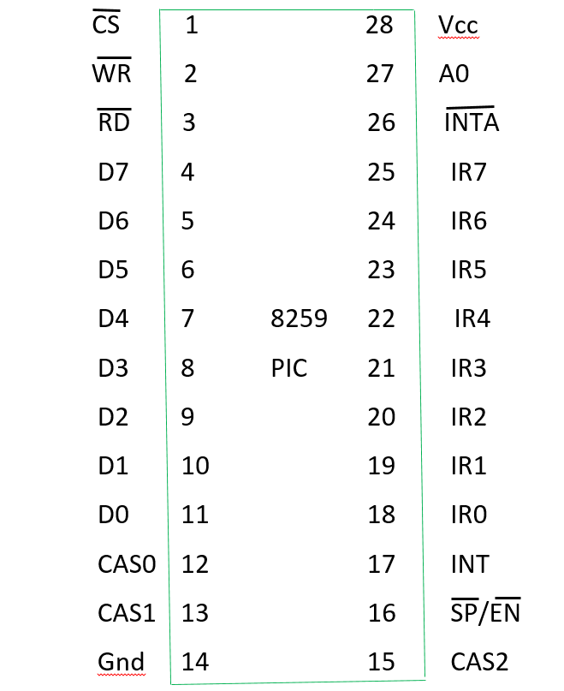
Introduction
Power Supply Pins: Vcc, GND
Interrupt Request Lines: IR0-IR7
Interrupt Request Line: INT
Interrupt Acknowledge Line: INTA
Chip Select Line: CS
Read/Write Line: RD/WR
Data Bus: D0-D7
Cascade Input/Output Lines: CAS0, CAS1, CAS2

Slide 6
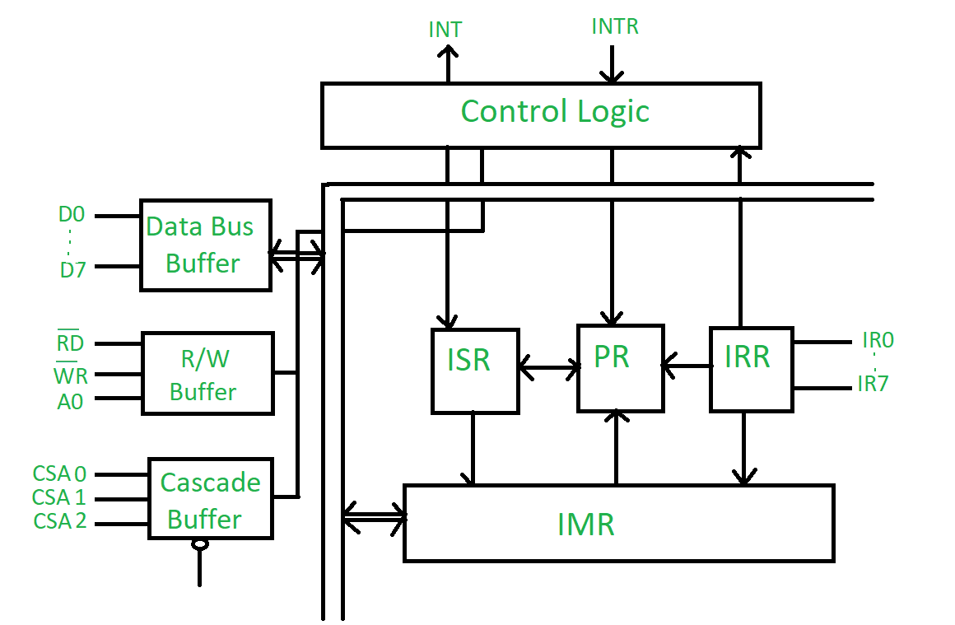
Architecture of 8259
Interrupt Request Register (IRR): Stores pending interrupt requests
In-Service Register (ISR): Stores currently being serviced interrupts
Interrupt Mask Register (IMR): Masks or unmasks interrupt requests
Priority Resolver: Determines the highest priority interrupt request

Slide 7
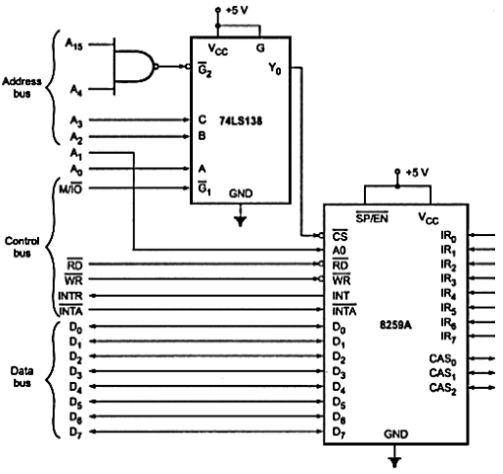
Interfacing 8259 with 8086
Initialization:
Program the 8259 using ICW1-ICW4
Set up interrupt vectors in the 8086's interrupt vector table
Interrupt Request:
A peripheral device asserts an interrupt request on one of the IR lines
8259 generates an INT signal to the 8086
Interrupt Acknowledge:
8086 sends an INTA signal to the 8259
8259 sends the interrupt vector number to the 8086
Interrupt Service Routine (ISR):
8086 executes the ISR corresponding to the interrupt vector
ISR should end with an IRET instruction to return control to the interrupted program

Slide 8
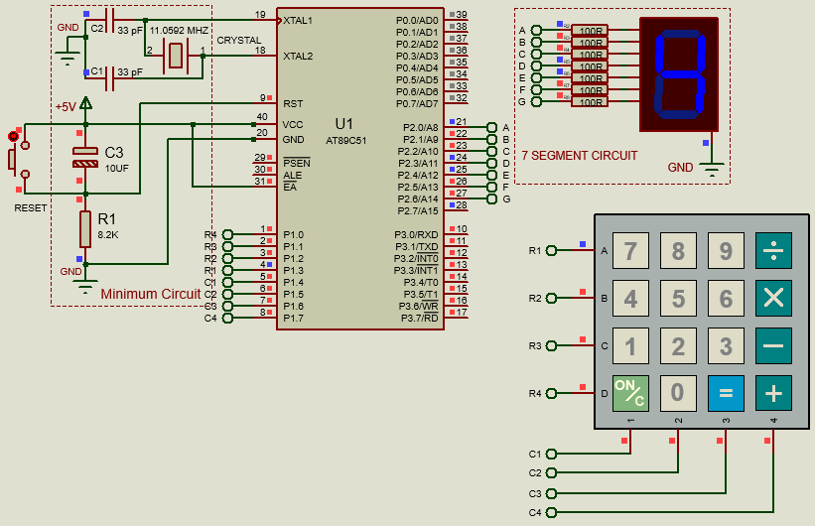
Application Example: Keyboard Interface with 8086 and 8259

Slide 9
Application Example: Keyboard Interface with 8086 and 8259
Hardware Setup:
Connect keyboard matrix to 8255
Connect 8255 to 8086
Connect 8259 to 8086
Software Implementation:
Initialize 8255 and 8259
Poll keyboard matrix for keypresses
Generate interrupt on keypress
ISR reads keycode and processes it

Slide 10
An Example Project
Keyboard Interrupt
a) Each ISR should acknowledge the interrupt
b) Service the interrupt (e.g., read keyboard input, update timer, process serial data)
c) Return from interrupt
; ... (Initialization code for 8259)
; Keyboard Interrupt Service Routine
KEYBOARD_ISR:
; Read keyboard input
IN AL, DX ; Read keyboard data from input port
; Process the keypress
; (e.g., display character on screen, store in buffer)
; Acknowledge the interrupt
MOV AL, 20H
OUT 20H, AL
IRET

Slide 11
Conclusion
8259 is a versatile interrupt controller
It simplifies interrupt handling in 8086-based systems
It can be used in various applications, such as keyboard interfacing, timer-based tasks, and device communication

Slide 12
Thanks

